Slide 1
NoSQL Databases
CSCE 3420
Internet Development

Slide 2
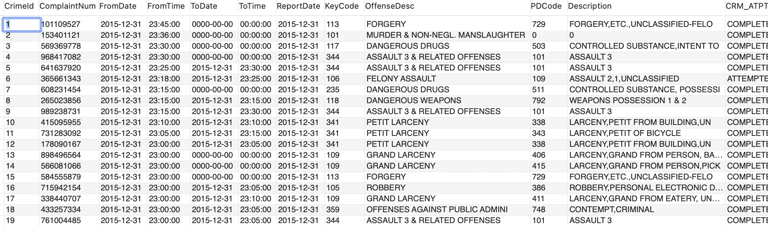
Why NoSQL
Relational Databases are great for ‘square’ data
Every row contains the same information

Slide 3
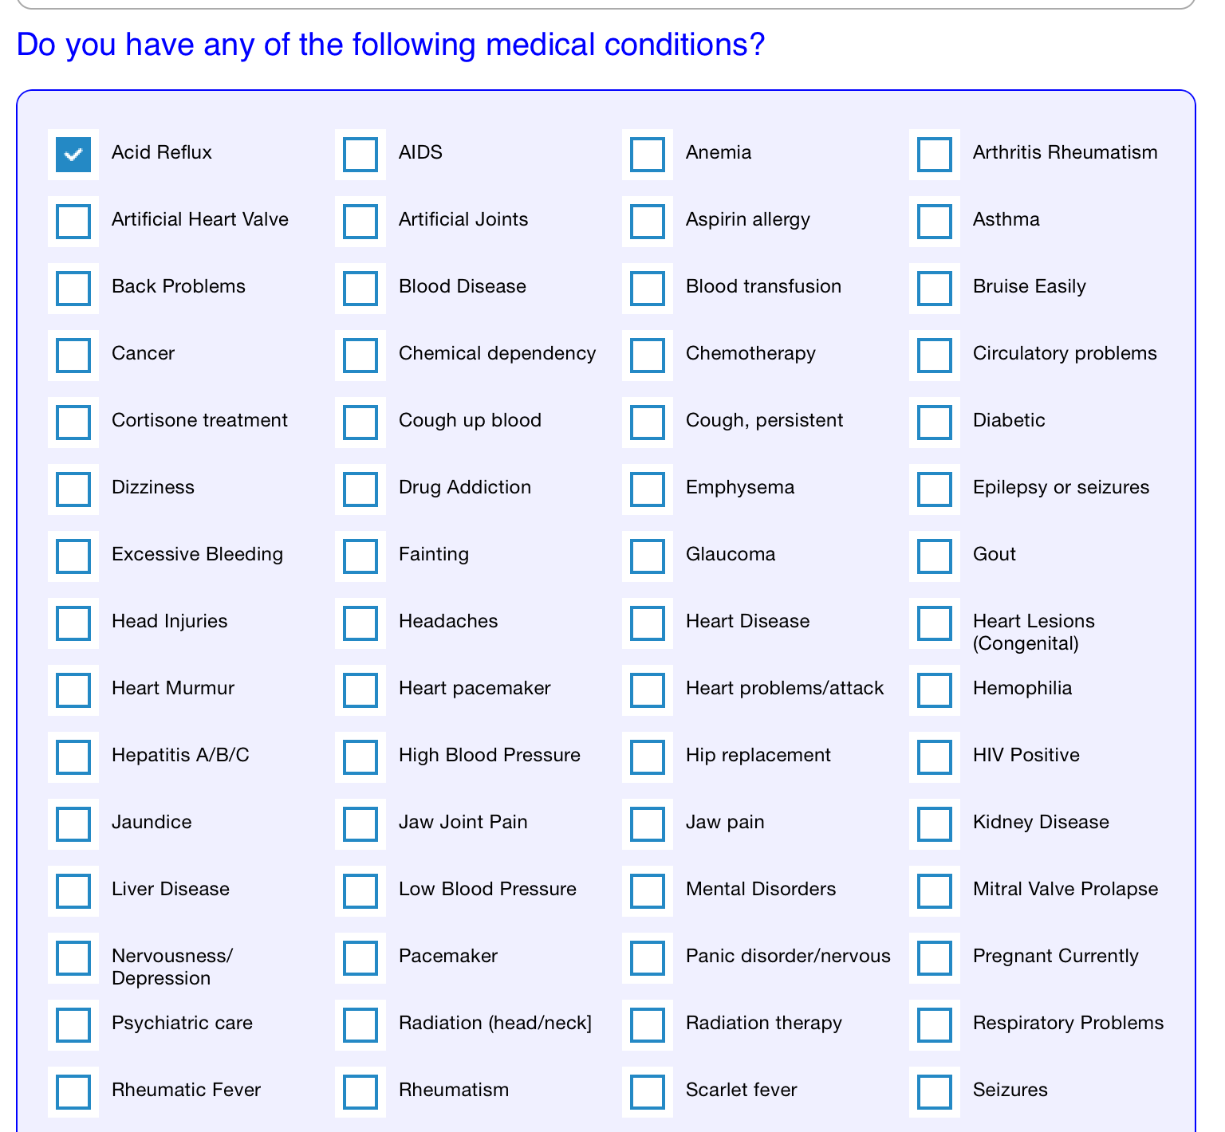
Where NoSQL Shines
Non-square data
Having a column for T/F for each condition would be extremely wasteful
Much better if we just save the conditions the patient DOES have

Slide 4
How has this been addressed over the years

Slide 5
Data Serialization
EDI – early 70s
XML – 1996
YAML – 2001
JSON – 2001

Slide 6
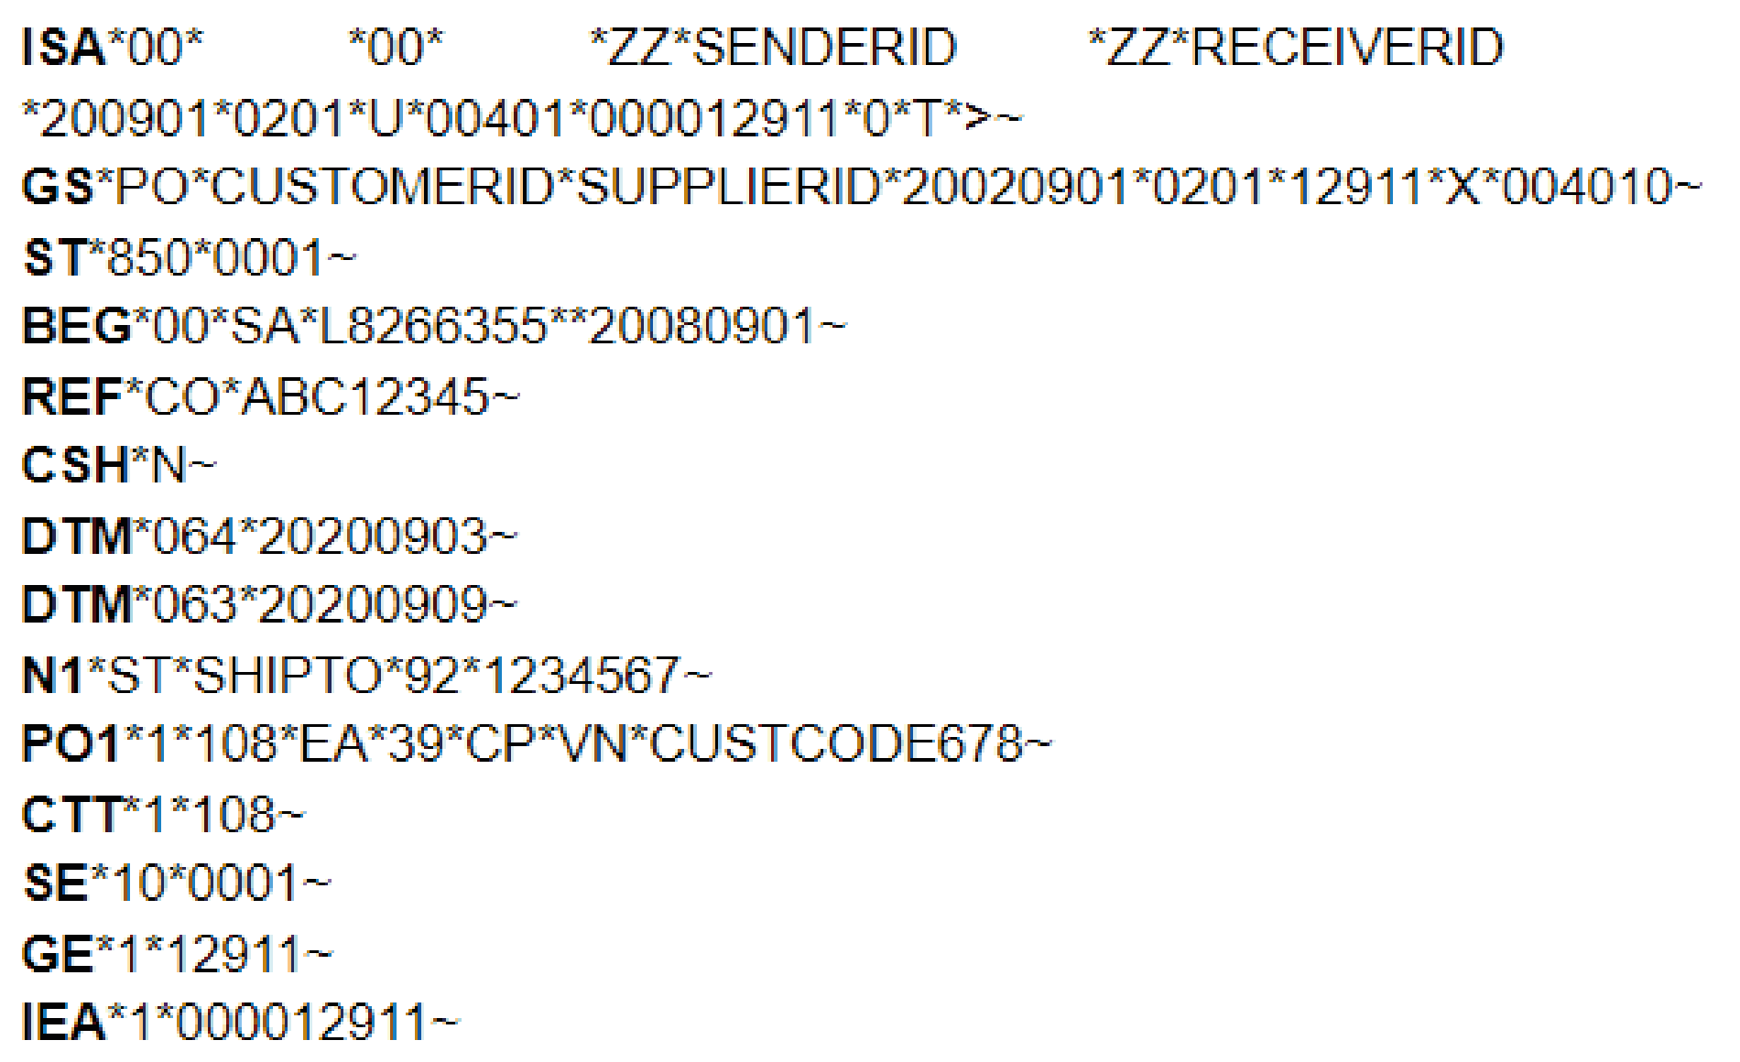
In the beginning was EDI Electronic Data Interchange
ISA – Start of interchange
GS – Start of functional group
ST – Start of transaction set
SE – End of transaction set
GE – End of functional group
IEA – End of Interchange

Slide 7
XML eXtensible Markup Language
Similar syntax to HTML
Designed to transport data
Designed to be self-descriptive
<address> <street>1015 Main St.</street > <city>Denton</city> <zip>76540</zip> <state>Texas</state> </address>
<note> <to>Ted</to> <from>Jani</from> <heading>Reminder</heading> <body>Don't forget me this weekend!</body> </note>

Slide 8
YAML Yet Another Markup Language
# This file holds all sidebar menu's entries.
- title: Getting started
pages:
- title: Introduction
- title: Download
- title: Contents
- title: Browsers & devices
- title: JavaScript
- title: Customize
pages:
- title: Overview
- title: Sass
- title: Options
- title: Color
- title: Optimize
- title: Layout
pages:
- title: Breakpoints
- title: Containers
- title: Grid
- title: Columns
- title: Gutters
- title: Utilities
- title: Z-index
- title: Content
pages:
- title: Reboot
- title: Typography
- title: Images
- title: Tables
- title: Figures

Slide 9
YAML Features
Readable
Short Syntax (strict! Syntax)
Language independent
Ease of use
Hierarchy is represented with indentation
-address
-Street: “1015 Main St”
-City: “Denton”
-Zip: “76540”
-State: “Texas”

Slide 10
JSON JavaScript Object Notation
Lightweight data interchange format
Language independent
Self-describing
Easy to understand
{
address: { street: “1015 Main St.”, city : “Denton”, zip : “76540”, state : “Texas”
} }
{
note: { to: “Ted”,
from: “Jani”,
heading: “Reminder”,
body: “Don't forget me this weekend!”
} }

Slide 11
NoSQL
Fast
Flexible
Built for APIs

Slide 12
Let’s look at a NoSQL database

Slide 13
DynamoDB
Partitioning Data is incorporated with the creation of the database
Choose an attribute that serves as a significant discriminator for the data
Business divisions, Location, Age, Nationality,
Think about viewing the data and what natural groupings there are

Slide 14
NoSQL data types
NoSQL data types lean heavily on JSON
But they still have data types
Number
String
Date
Bool

Slide 15
Partition Key – Natural grouping of data
Primary Key – Unique record to the table
Secondary Index – Used to search on other fields
Other wise you incur a scan of the whole table
Types – ‘S’ – String, ‘N’ – Number, ‘D’ – Date, ‘B’ – Bool
Add Fields as you wish
Bulk load many rows

Slide 16
Table attributes
New attributes
Can be added to just a single row
Do not affect old rows of data
Can be added at any time

Slide 17
Searching
Add a key to the table for high use attributes
Without an index the entire table is scanned

Slide 18
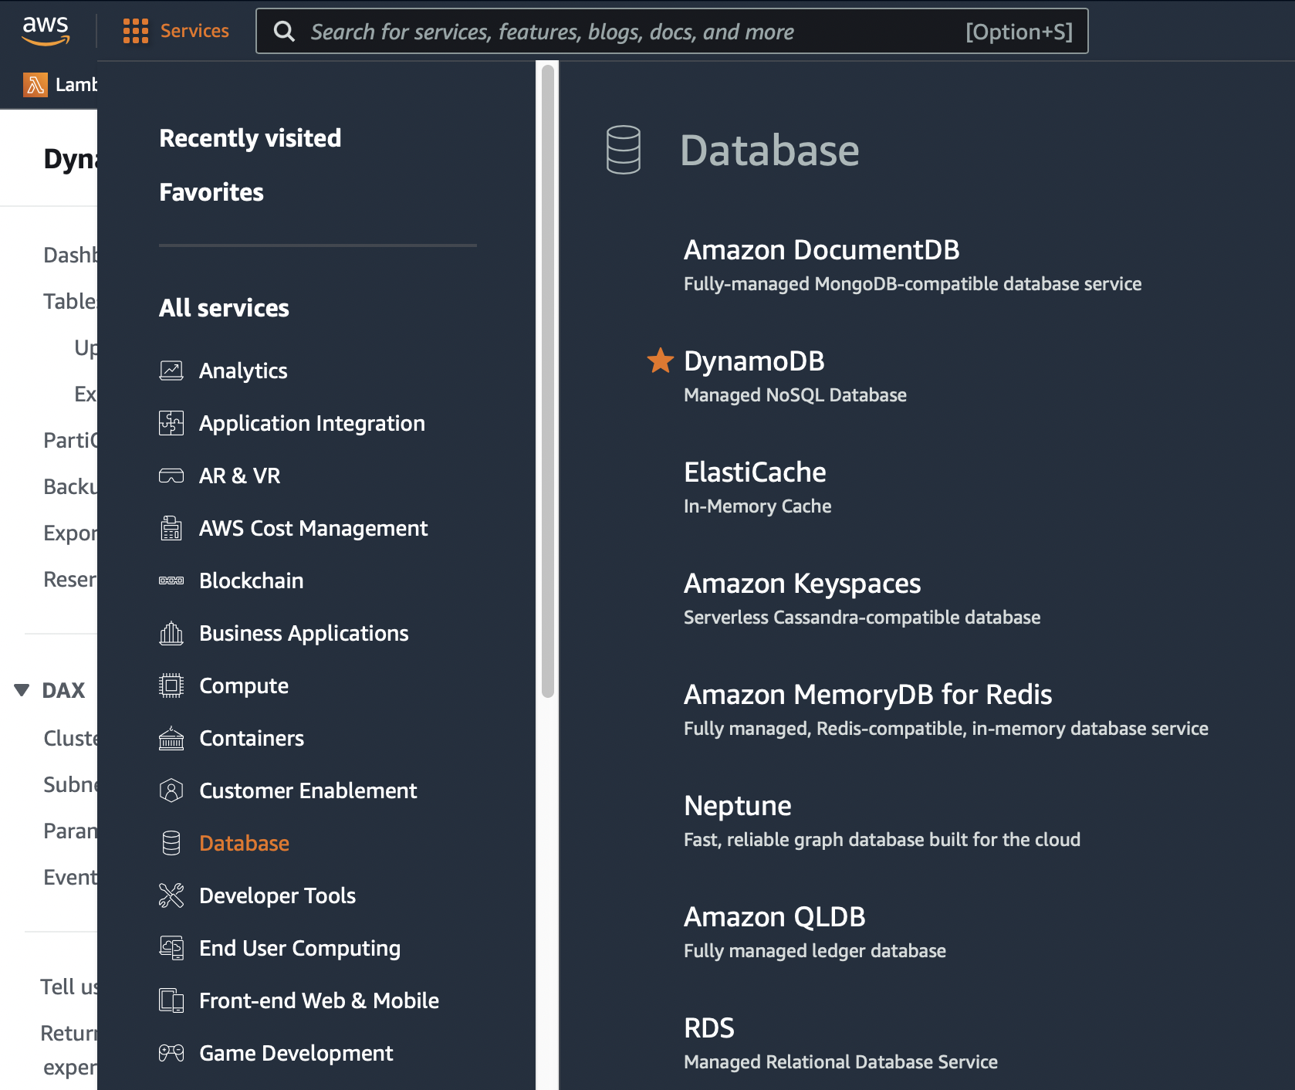
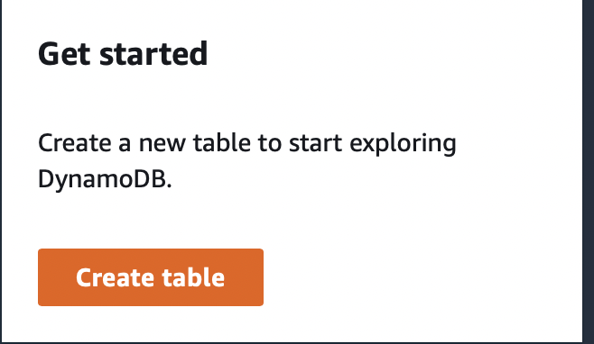
Let’s Create a Table

Slide 19
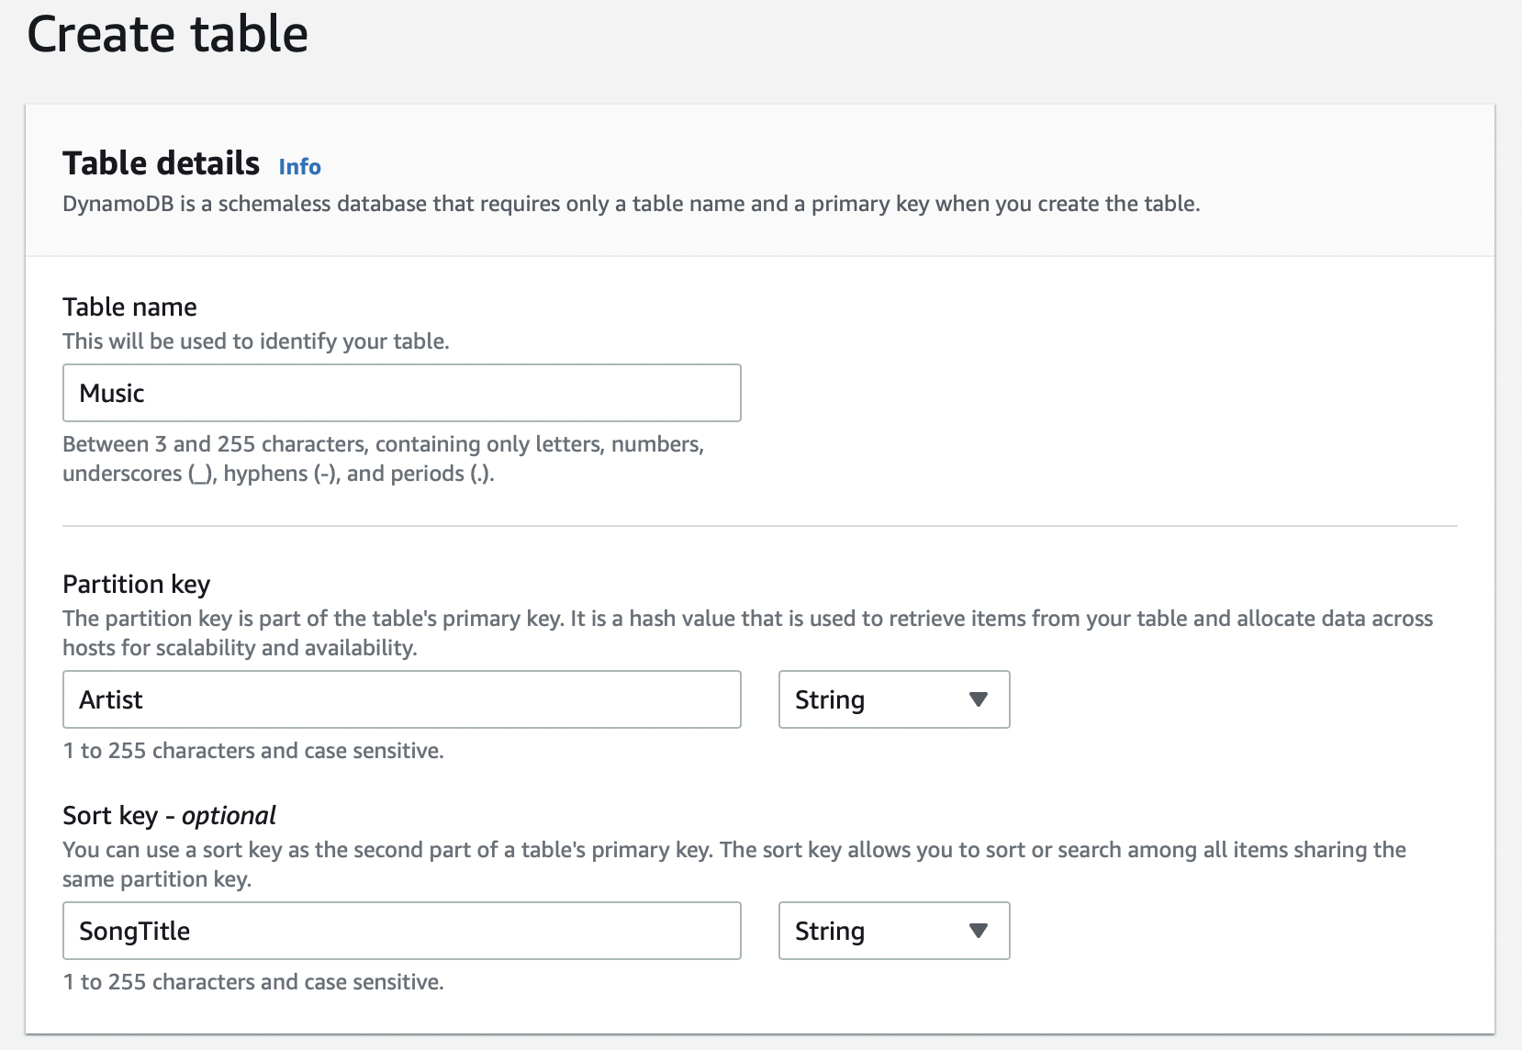
Create Table

Slide 20
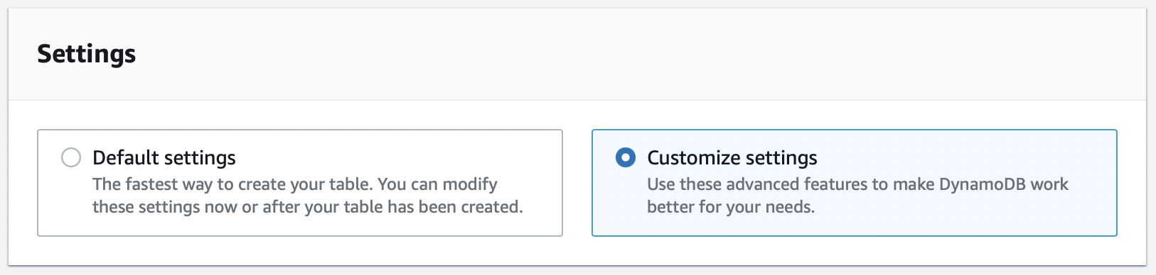
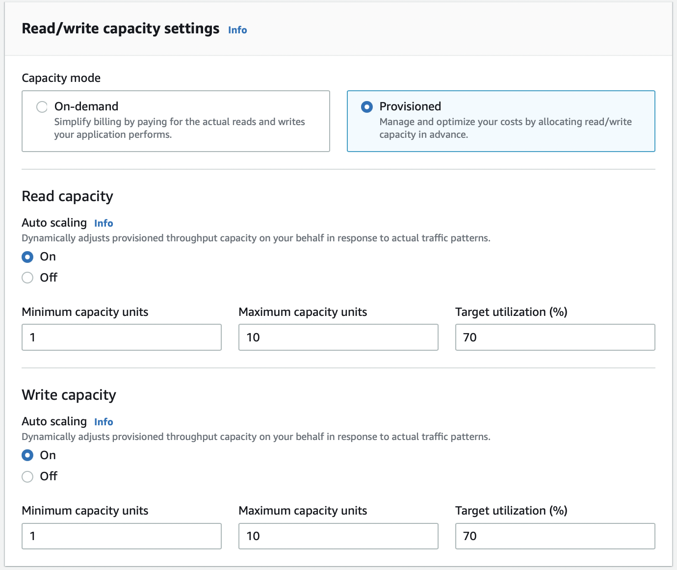

Custom Settings if desired

Slide 21
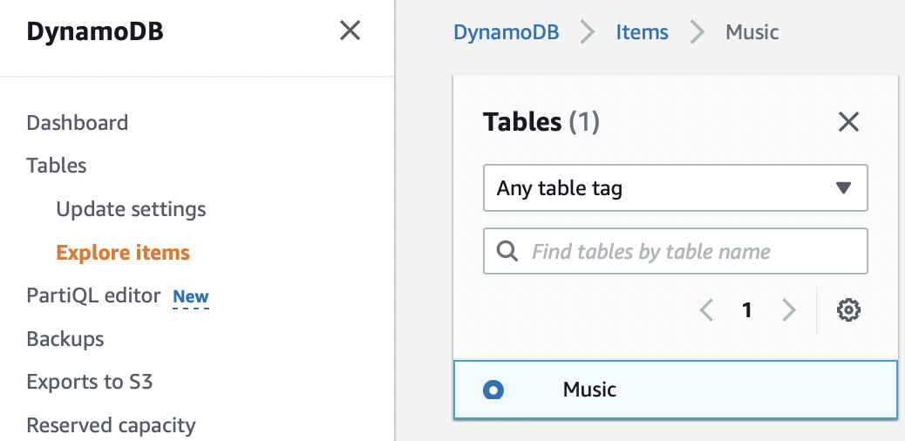
Adding Data

Slide 22
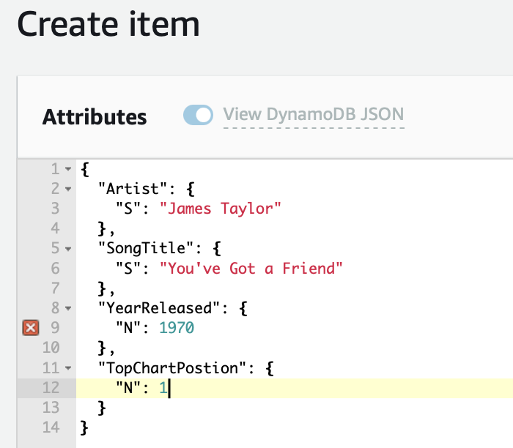
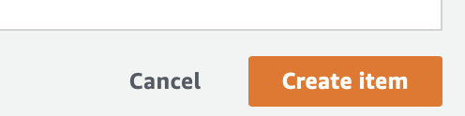
Wash, Rinse, Repeat

Slide 23
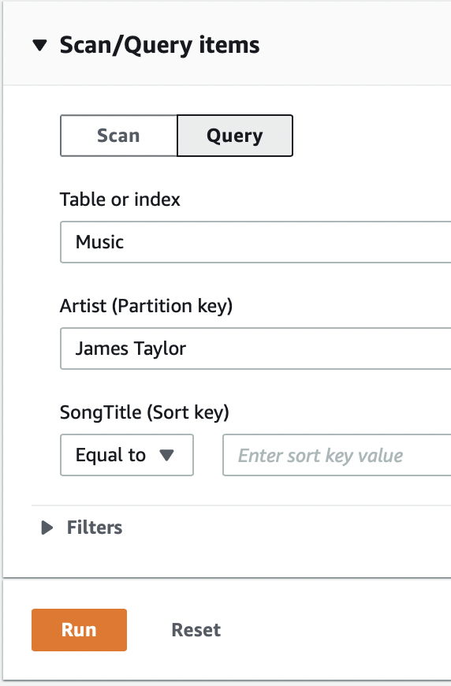
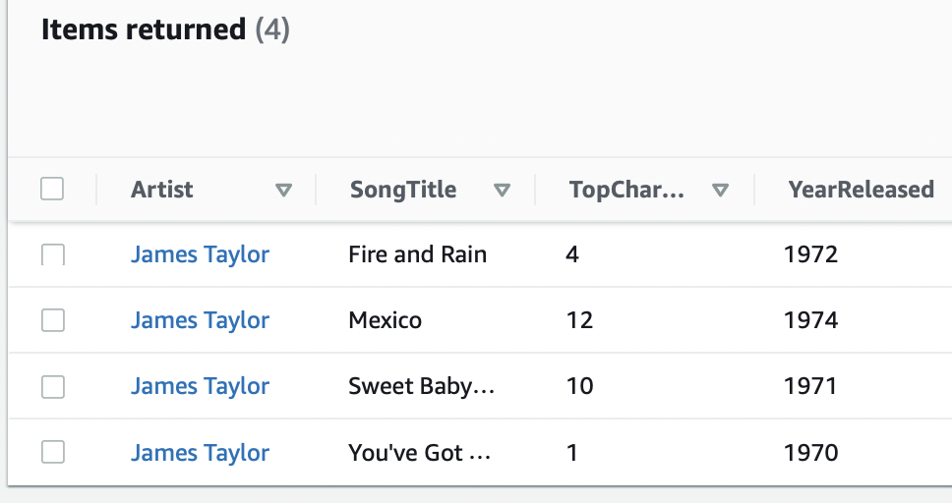
Query

Slide 24
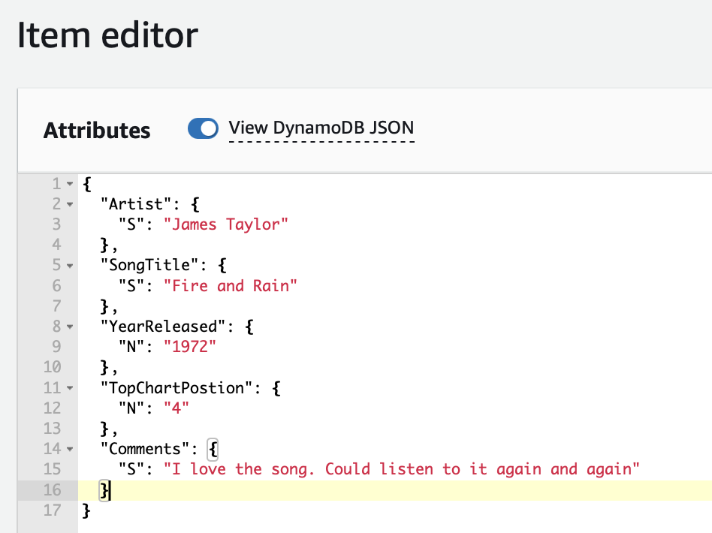
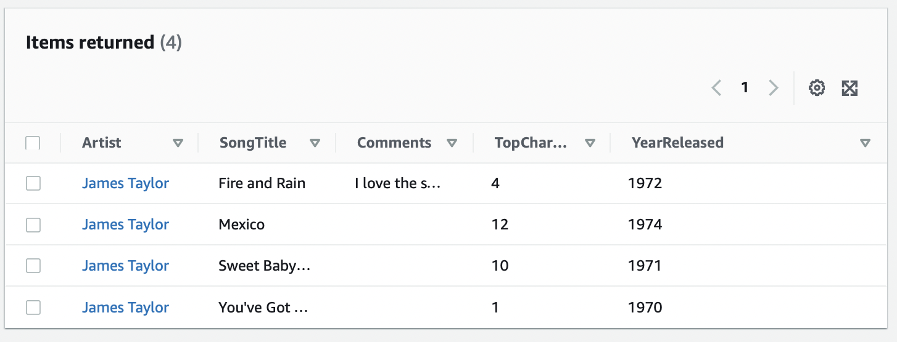
Adding a new Attribute

Slide 25
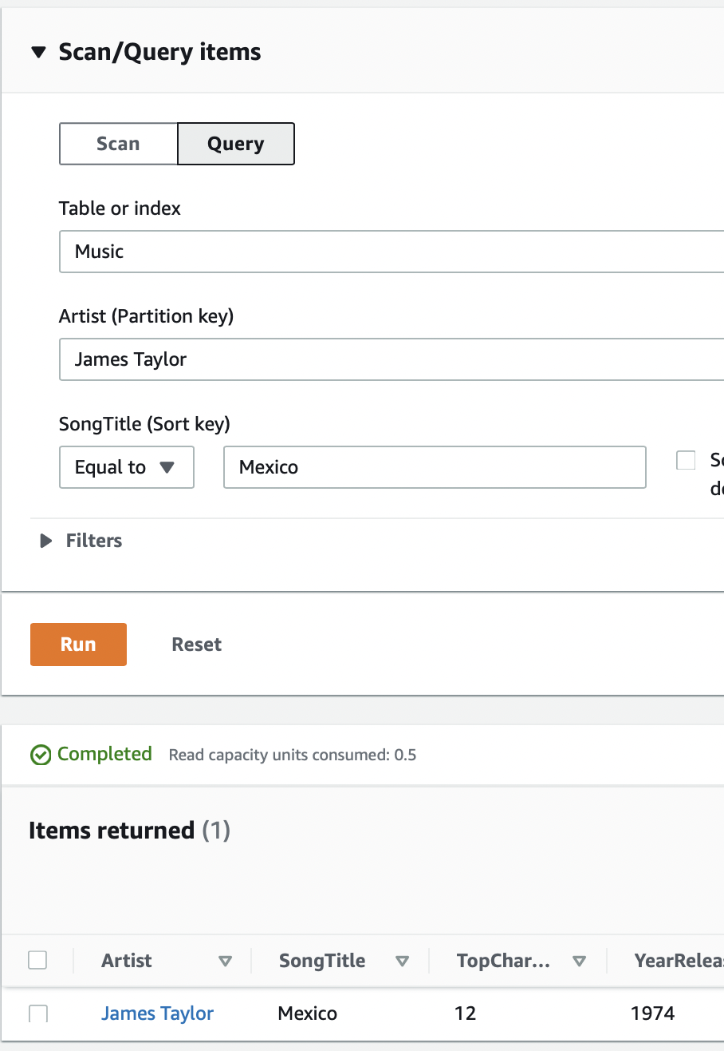
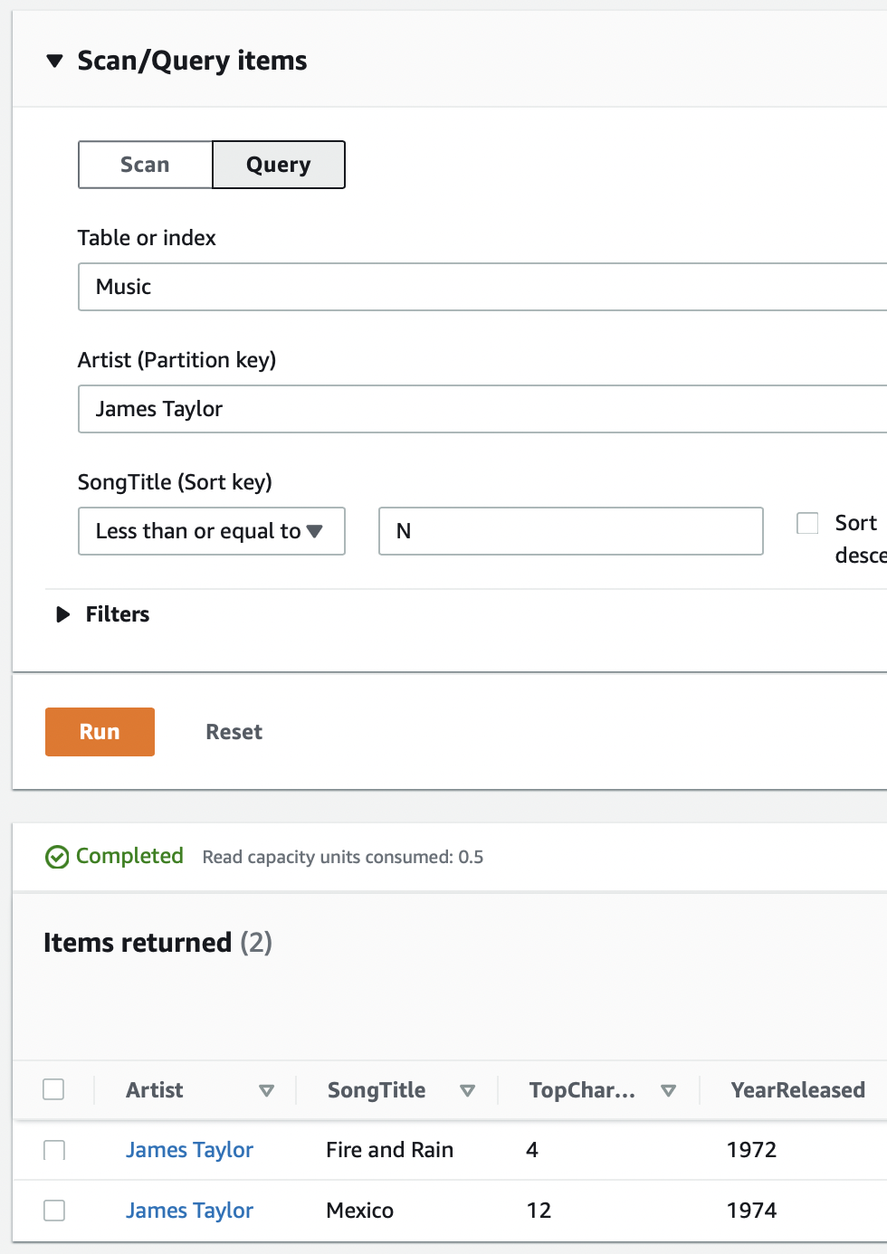

Slide 26
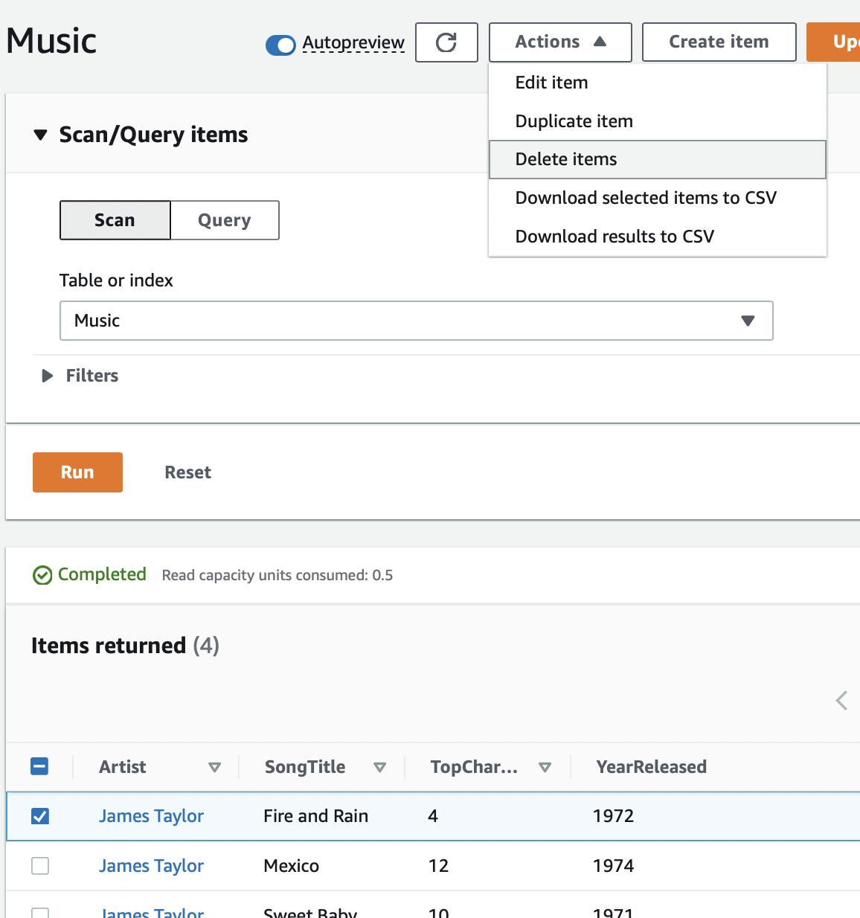
Deleting a Record

Slide 27
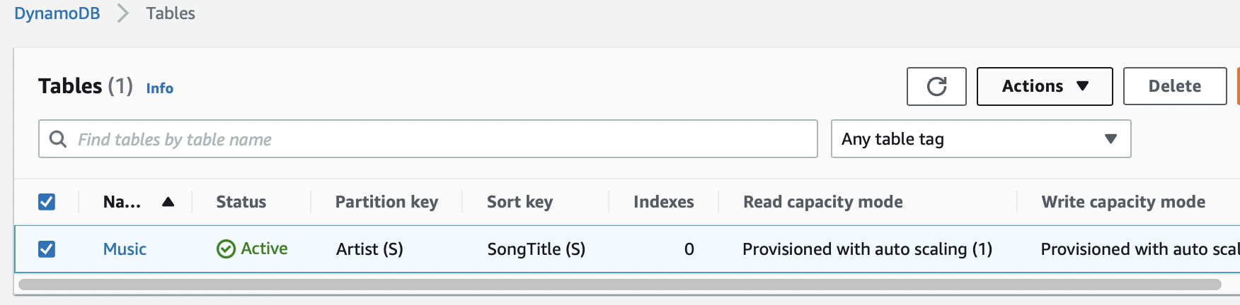
Deleting the Table

Slide 28
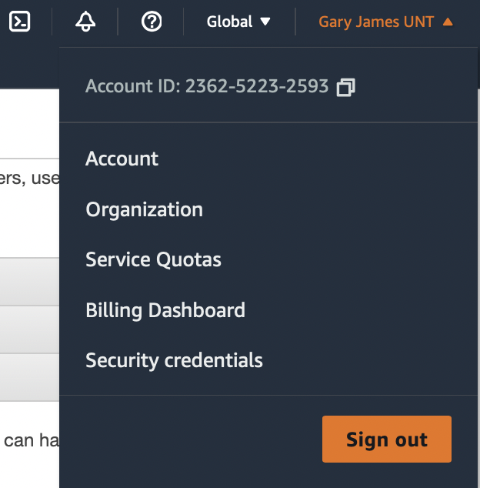
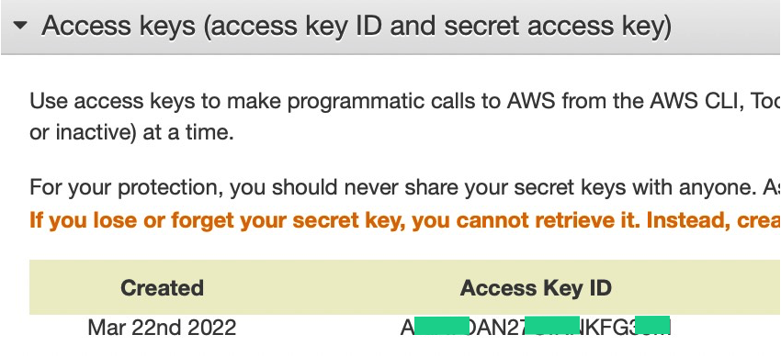
AWS CLI
aws configure
aws dynamodb scan --table-name Music

Slide 29
Bulk Insert
aws dynamodb batch-write-item \
--request-items file://music.json \
--return-consumed-capacity INDEXES \
--return-item-collection-metrics SIZE

Slide 30
{
"Music": [
{
"PutRequest": {
"Item": {
"Artist": {"S": "No One You Know"},
"SongTitle": {"S": "Call Me Today"},
"AlbumTitle": {"S": "Somewhat Famous"}
}
}
}, ………..
]
}

